Slide 1
Convolutional neural networks
Aashish Pandey

Slide 2

Agenda
CNN Introduction

Slide 3
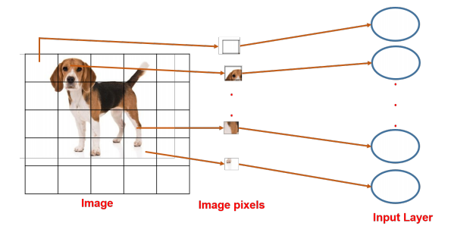
Image classification

Slide 4
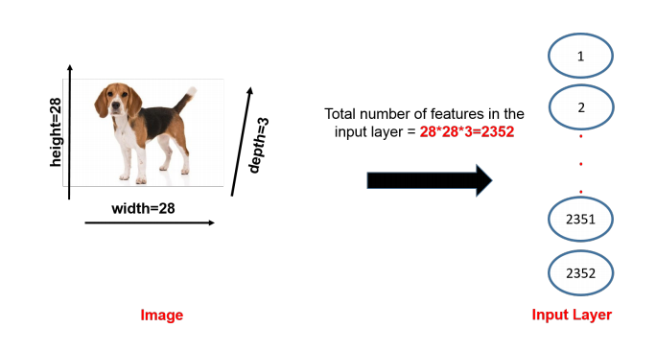
Why not DNN?

Slide 5
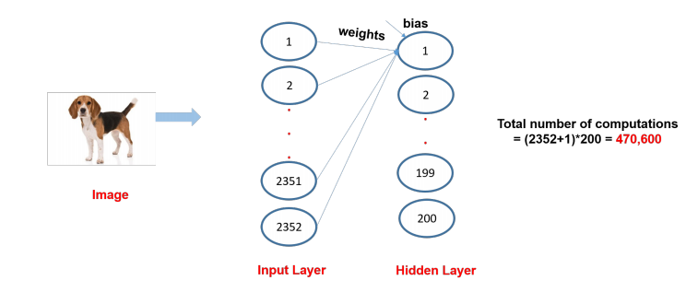
COMPUTATION COST IN FIRST HIDDEN LAYER
Suppose there are 200 hidden neurons in the first hidden layer, each hidden layer neuron will have 2352 weights and 1 bias.

Slide 6
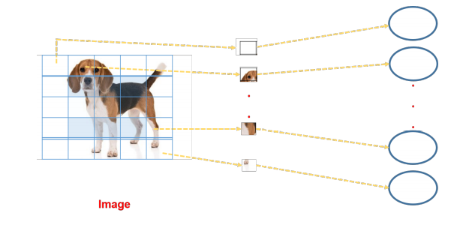
LOSS OF SPATIAL INFORMATION
We input pixel-wise to the input layer neurons, thus losing the neighboring pixel correlation of images.

Slide 7
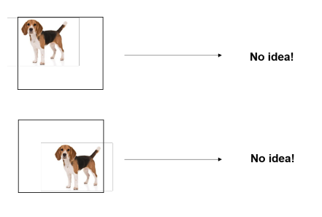
MISSCLASSIFICATION
Fully connected neural nets also cannot capture a shift in object positions . i.e they are not translation invariant.
Neural network is trained on images that are perfectly centered which is why it is not able to detect images that are slightly shifted.

Slide 8
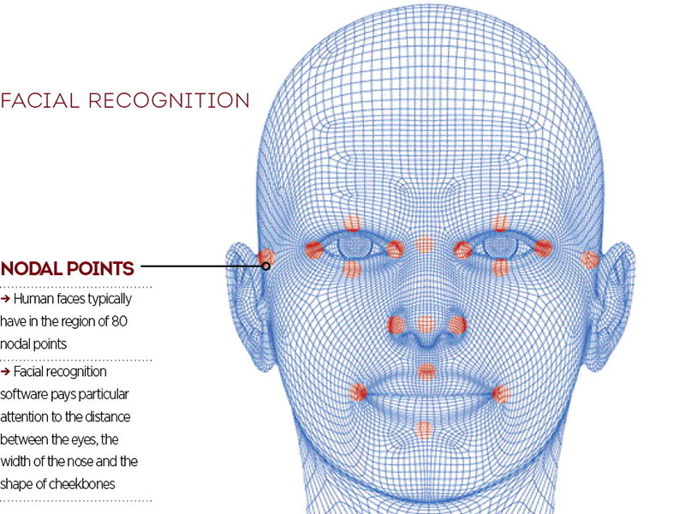
Convolutional Neural Network

Slide 9
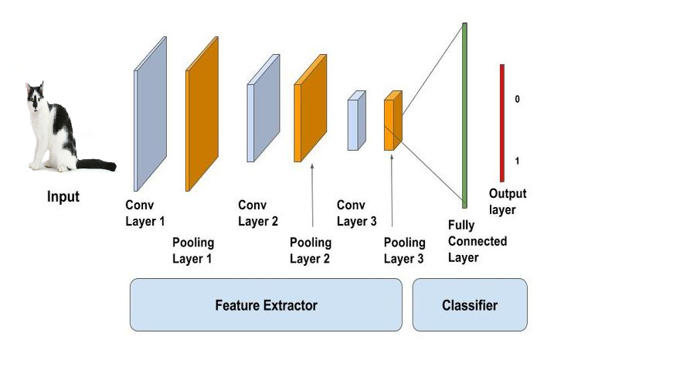
Convolutional Neural Networks
A convolutional neural network (CNN, or ConvNet) is one of the most popular algorithms for deep learning with images and video.
Like other neural networks, a CNN is composed of an input layer, an output layer, and many hidden layers in between.

Slide 10
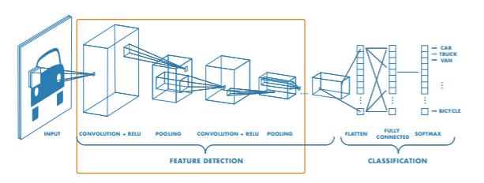
Feature Detection Layers
These layers perform one of three types of operations on the data: convolution, pooling, or rectified linear unit (ReLU).
Convolution puts the input images through a set of convolutional filters, each of which activates certain features from the images.
Pooling simplifies the output by performing nonlinear downsampling, reducing the number of parameters that the network needs to learn about.
Rectified linear unit (ReLU) allows for faster and more effective training by mapping negative values to zero and maintaining positive values.
These three operations are repeated over tens or hundreds of layers, with each layer learning to detect different features.

Slide 11
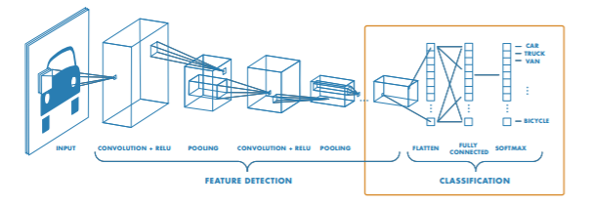
Classification Layers
After feature detection, the architecture of a CNN shifts to classification.
The next-to-last layer is a fully connected layer (FC) that outputs a vector of K dimensions where K is the number of classes that the network will be able to predict. This vector contains the probabilities for each class of any image being classified.
The final layer of the CNN architecture uses a softmax function to provide the classification output.

Slide 12
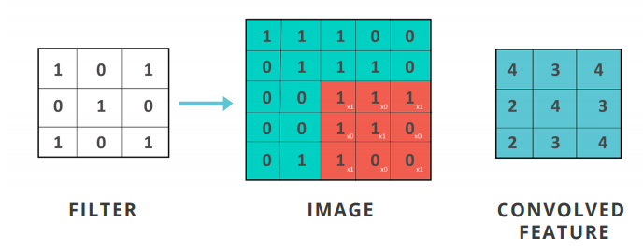
What is convolution?
Convolution is a mathematical operation that manipulates values in a matrix, by sliding a mask or a filter over the image to get desired output.

Slide 13
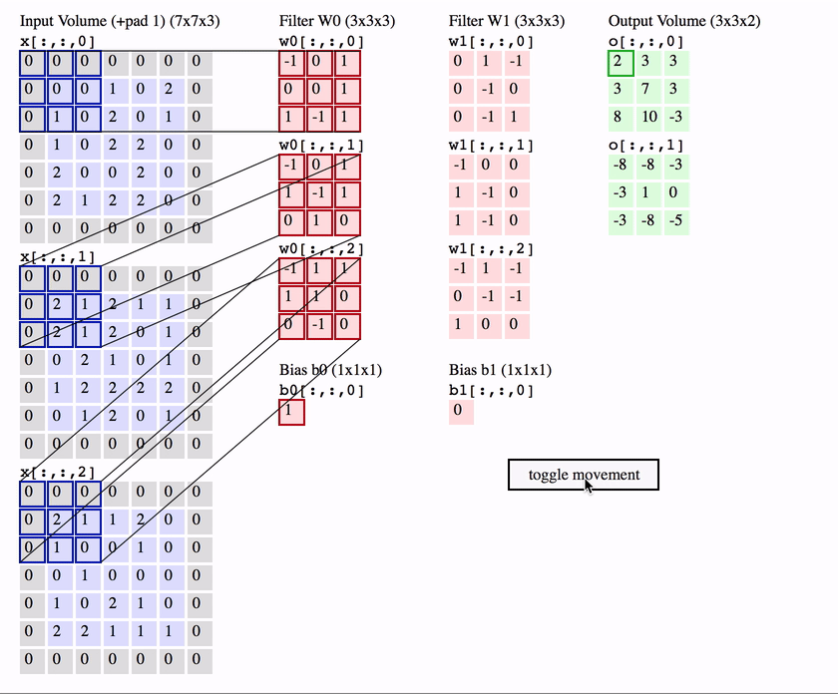
Convolution Process

Slide 14
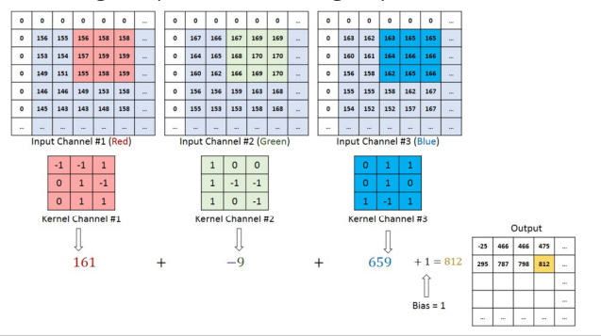
Convolution Process
Filters are building blocks of CNN that perform convolution with small regions of the image to produce meaningful patterns.

Slide 15
CHARACTERISTICS OF FILTERS IN CNNs
Filters are analogical to the weights in neural networks.
Each filter is convolved with the image and the same filter is applied across the entire image thus saving on numerous parameters for weights
There are several filters in a single convolutional layer

Slide 16
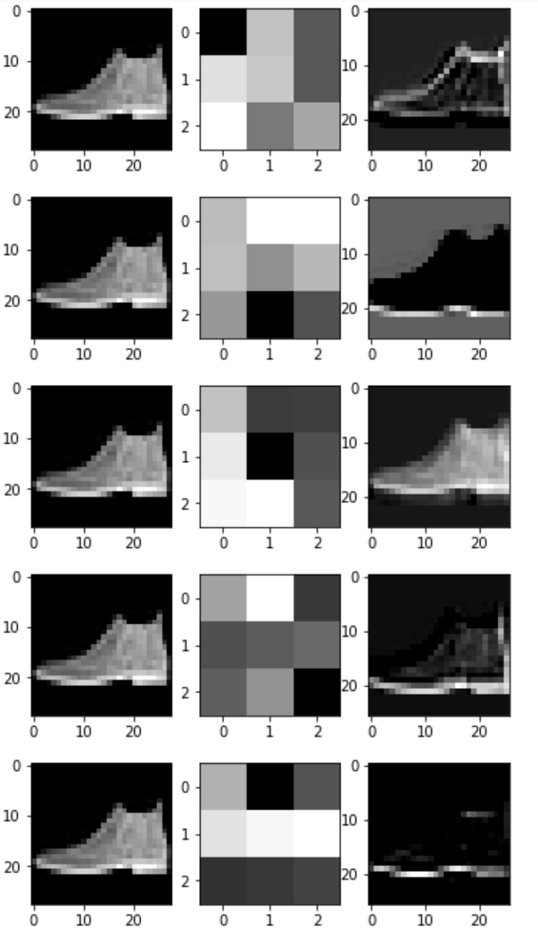
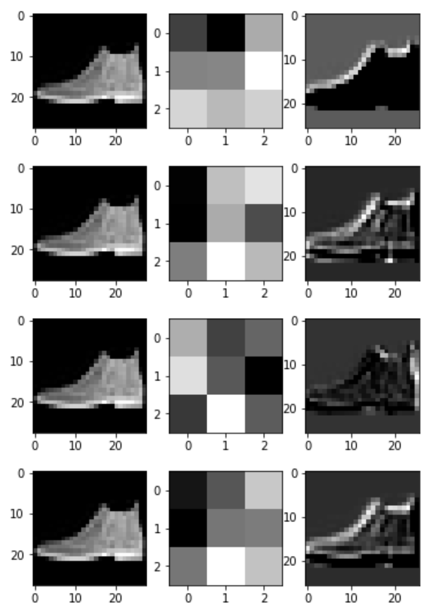
PICTORIAL REPRESENTATION OF CONVOLUTION

Slide 17
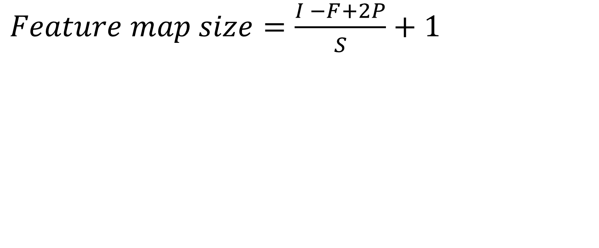
Size of output feature map
$Feature map size=\frac{I −F+2P}{S}+1$
Where
I = size of input image
F = filter size (OR kernel size)
P = Number of zero padding layers
S = strides

Slide 18
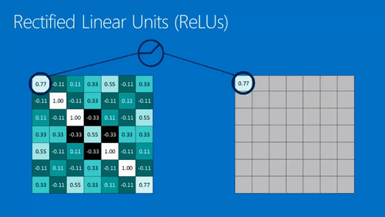
Relu

Slide 19

Maxpooling

Slide 20
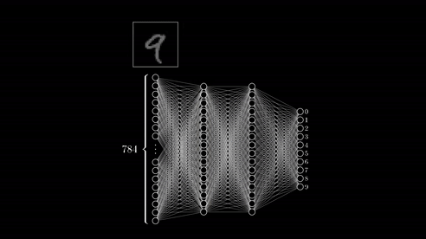
CNN

Slide 21
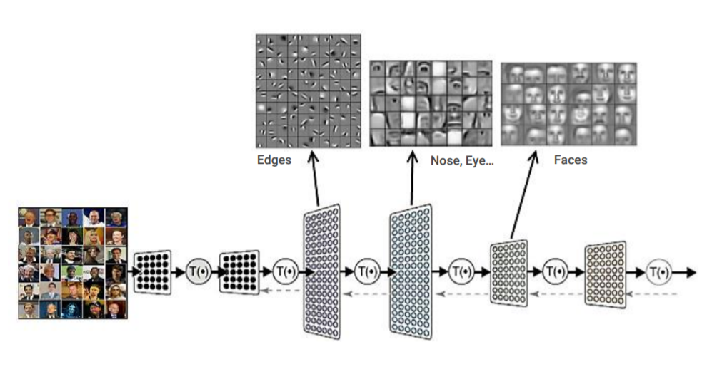

Slide 22
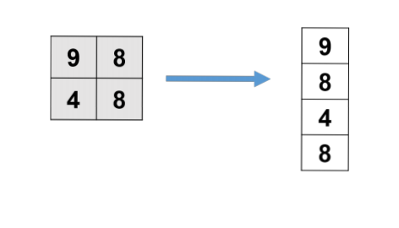
FLATTEN LAYER
Flattening is the process of converting the array obtained from pooled feature map into a single long continuous linear vector.

Slide 23
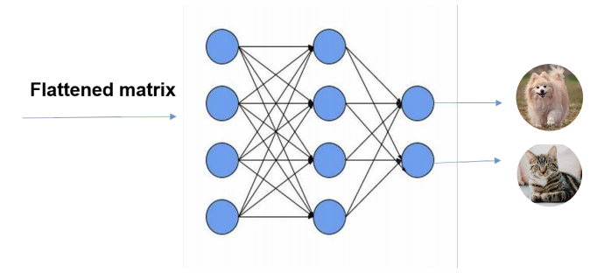
FULLY CONNECTED LAYER
Flattened layer is then fed as input to fully connected layer to classify the image

Slide 24
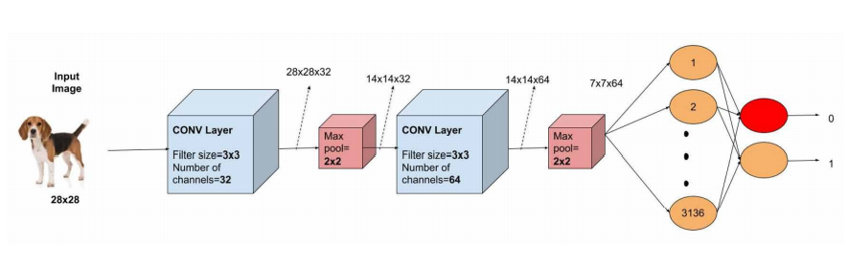
SUMMARY: LAYERS IN CONVOLUTIONAL NEURAL NETWORK

Slide 25
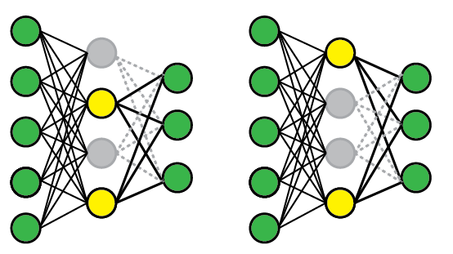
Dropout
To apply DropOut, we randomly select a subset of the units and clamp their output to zero, regardless of the input; this effectively removes those units from the model. A different subset of units is randomly selected every time we present a training example.
At test time, we use the complete network but rescale the weights to compensate for the fact that all of them can now become active (e.g., if you drop half of the nodes, the weights should also be halved).

Slide 26
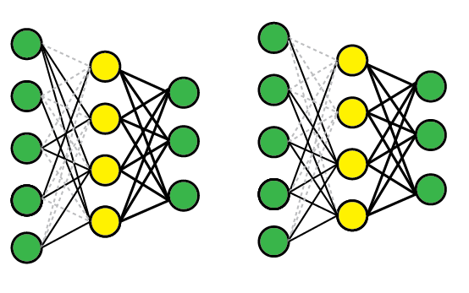
DropConnect
DropConnect works similarly, except that we disable individual weights (i.e., set them to zero), instead of nodes, so a node can remain partially active.

Slide 27
Example

Slide 28
MNIST Dataset
The MNIST database (Modified National Institute of Standards and Technology database) is a large database of handwritten digits that is commonly used for training various image processing systems. The database is also widely used for training and testing in the field of machine learning.
The MNIST database of handwritten digits, has a training set of 60,000 examples, and a test set of 10,000 examples. It is a subset of a larger set available from NIST. The digits have been size-normalized and centered in a fixed-size image of size 28x28.
It can manually be downloaded from - http://yann.lecun.com/exdb/mnist/

Slide 29
Importing libraries
import numpy as np
import tensorflow
from keras.models import Sequential
from keras.layers import Dense, Dropout, Flatten
from keras.layers.convolutional import Conv2D, MaxPooling2D
from keras import backend
import matplotlib.pyplot as plt
from keras.utils import np_utils

Slide 30
Load data
from keras.datasets import mnist
# Load data and target from MNIST data
(train_data, train_target), (test_data, test_target) = mnist.load_data()

Slide 31
Feature Engineering on data
# Set image information
channels = 1
height = 28
width = 28
# Reshape training image data into features
train_data = train_data.reshape(train_data.shape[0], channels, height, width)
# Reshape test image data into features
test_data = test_data.reshape(test_data.shape[0], c

Slide 32
Feature Engineering on data
# Rescale pixel intensity to between 0 and 1
train_features = train_data / 255
test_features = test_data / 255
# One-hot encode target
train_target = np_utils.to_categorical(train_target)
test_target = np_utils.to_categorical(test_target)
number_of_classes = test_target.shape[1]

Slide 33
Convolutional Neural Network
# Start neural network
network = Sequential()

Slide 34
Convolutional Neural Network
# Add convolutional layer with 64 filters, a 5x5 window, and
# ReLU activation function
network.add(Conv2D(filters=64, kernel_size=(5, 5), input_shape=(channels, width, height), activation='relu'))

Slide 35
Convolutional Neural Network
# Add max pooling layer with a 2x2 window
network.add(MaxPooling2D(pool_size=(2, 2)))

Slide 36
Convolutional Neural Network
# Add dropout layer
network.add(Dropout(0.5))

Slide 37
Convolutional Neural Network
# Add layer to flatten input
network.add(Flatten())

Slide 38
Convolutional Neural Network
# Add fully connected layer of 128 units with a ReLU activation function
network.add(Dense(128, activation='relu'))

Slide 39
Convolutional Neural Network
# Add dropout layer
network.add(Dropout(0.5))

Slide 40
Convolutional Neural Network
# Add fully connected layer with a softmax activation function
network.add(Dense(number_of_classes, activation='softmax'))

Slide 41
Compile Convolutional Neural Network
# Compile neural network
network.compile(loss='categorical_crossentropy', # Cross-entropy
optimizer='rmsprop', # Root Mean Square Propagation
metrics=['accuracy']) # Accuracy performance metric

Slide 42
Train Convolutional Neural Network
# Train neural network
network.fit(train_features, # Features
train_target, # Target
epochs=2, # Number of epochs
verbose=0, # Don't print description after each epoch
batch_size=1000, # Number of observations per batch
validation_data=(test_features, test_target))# evaluation

Slide 43
Prediction
# predicting the image
img=test_data[0]
network.predict_classes(img.reshape(1,1,28,28))
# visualizing the image
plt.imshow(img.reshape(28,28),cmap='gray')
plt.show()

Slide 44
Use cases
Text Processing ( Sensitivity Analysis, Named Entity recognition)
- RNTN (Recursive Neural Tensor Network) OR Recurrent Net
Image Recognition – DBN(Deep Belief Network), Convolution Net
Object Recognition – RNTN, Convolution Net
Speech Recognition - Recurrent Net

Slide 45
For Projects http://cs229.stanford.edu/projects2013.html
For python Libraries http://www.lfd.uci.edu/~gohlke/pythonlibs/
For ML Data http://archive.ics.uci.edu/ml/index.php
Scikit-Learn http://scikit-learn.org/stable/
Data Mining Book https://www.amazon.com/dp/0123748569

Slide 46

Thank you
Anshu Pandey
https://www.linkedin.com/in/anshupandey/

